Slide 1

DFA Minimization
MTCS101/U-II

Slide 2
DFA Minimization: The Idea
“Minimal”?
  Minimal number of states.
“Unique”?
  Unique up to renaming of states.
  I.e., has same shape. Isomorphic.
Will show algorithm & detailed example.
Will outline why algorithm is correct.

Slide 3

DFA Minimization: Algorithm Idea
Equate & collapse states having same behavior.
Build equivalence relation on states:
  p ≡ q ↔ (∀z∈Σ*, (p,z)∈F ↔ (q,z)∈F)
  I.e., iff for every string z, one of the following is true:
z
z
p
p
or
z
z
q
q

Slide 4
DFA Minimization: Algorithm
Build table to compare each unordered pair of distinct states p,q.
Each table entry has
  a “mark” as to whether p & q are known to be not equivalent, and
  a list of entries, recording dependences: “If this entry is later marked, also mark these.”

Slide 5
DFA Minimization: Algorithm
Initialize all entries as unmarked & with no dependences.
Mark all pairs of a final & nonfinal state.
For each unmarked pair p,q & input symbol a:
  Let r=δ(p,a), s=δ(q,a).
  If (r,s) unmarked, add (p,q) to (r,s)’s dependences,
  Otherwise mark (p,q), and recursively mark all dependences of newly-marked entries.
Coalesce unmarked pairs of states.
Delete inaccessible states.

Slide 6
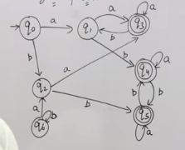
Example:

Slide 7
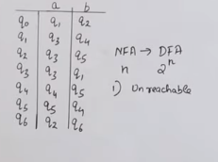
Example:

Slide 8
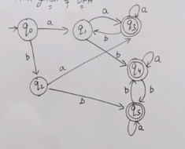
Example:
Remove unreachable states

Slide 9
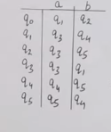
Example:
Similarly, remove unreachable states
from transition table

Slide 10
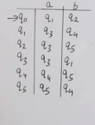
Example:
Mark start state

Slide 11
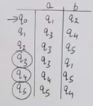
Example:
Mark Final states

Slide 12
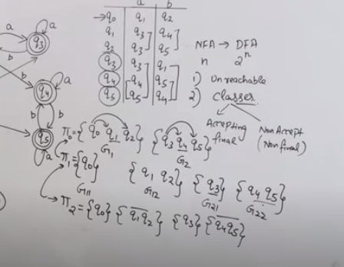
Create equivalent classes of accepting and non accepting states

Slide 13
DFA minimization
Algorithm 2

Slide 14
DFA Minimization: Example
0
1
0
1
0
a
b
c
d
b
1
0
1
0
1
1
1
0
e
f
g
h
c
1
0
d
0
e
Initialize table entries:
Unmarked, empty list
f
g
h
a
b
c
d
e
f
g

Slide 15
DFA Minimization: Example
0
1
0
1
0
a
b
c
d
b
1
0
1
0
1
1
1
0
e
f
g
h
c
1
0
d
0
Mark pairs of final &
nonfinal states
e
f
g
h
a
b
c
d
e
f
g

Slide 16
DFA Minimization: Example
0
1
0
1
0
δ(b,0) ≡? δ(a,0)
δ(b,1) ≡? δ(a,1)
a
b
c
d
b
1
0
1
0
1
1
1
0
e
f
g
h
c
1
0
d
0
For each unmarked
pair & symbol, …
e
f
g
h
a
b
c
d
e
f
g

Slide 17
DFA Minimization: Example
0
1
0
1
0
g ≡? b
c ≡? f
Maybe.
No!
a
b
c
d
b
1
0
1
0
1
1
1
0
e
f
g
h
c
1
0
d
0
For each unmarked
pair & symbol, …
e
f
g
h
a
b
c
d
e
f
g

Slide 18
DFA Minimization: Example
0
1
0
1
0
a
b
c
d
b
1
0
1
0
1
1
1
0
e
f
g
h
c
1
0
d
0
For each unmarked
pair & symbol, …
e
f
g
h
a
b
c
d
e
f
g

Slide 19
DFA Minimization: Example
0
1
0
1
0
δ(e,0) ≡? δ(a,0)
δ(e,1) ≡? δ(a,1)
a
b
c
d
b
1
0
1
0
1
1
1
0
e
f
g
h
c
1
0
d
0
For each unmarked
pair & symbol, …
e
f
g
h
a
b
c
d
e
f
g

Slide 20
DFA Minimization: Example
0
1
0
1
0
h ≡? b
f ≡? f
Maybe.
Yes.
a
b
c
d
b
1
0
1
0
1
1
1
0
e
f
g
h
c
1
0
d
0
For each unmarked
pair & symbol, …
e
f
g
h
(a,e)
a
b
c
d
e
f
g

Slide 21
DFA Minimization: Example
0
1
0
1
0
a
b
c
d
b
1
0
1
0
1
1
1
0
e
f
g
h
c
1
0
d
0
For each unmarked
pair & symbol, …
e
f
(g,a)
g
(g,a)
h
(a,e)
a
b
c
d
e
f
g

Slide 22
DFA Minimization: Example
0
1
0
1
0
a
b
c
d
b
Need to mark.
1
0
1
0
1
So, mark (g,a) also.
1
1
0
e
f
g
h
c
1
0
d
0
For each unmarked
pair & symbol, …
e
f
(g,a)
g
(g,a)
h
(a,e)
a
b
c
d
e
f
g

Slide 23
DFA Minimization: Example
0
1
0
1
0
a
b
c
d
b
1
0
1
0
1
1
1
0
e
f
g
h
c
1
0
d
0
For each unmarked
pair & symbol, …
e
f
(g,a)
g
h
(a,e)
a
b
c
d
e
f
g

Slide 24
DFA Minimization: Example
0
1
0
1
0
a
b
c
d
b
1
0
1
0
1
1
1
0
e
f
g
h
c
1
0
d
0
Coalesce unmarked
pairs of states.
e
f
0
1
0
1
g
a ≡ e
b ≡ h
d ≡ f
ae
bh
c
1
0
0
h
1
(a,e)
1
df
g
0
a
b
c
d
e
f
g

Slide 25
DFA Minimization: Example
0
1
0
1
0
a
b
c
d
b
1
0
1
0
1
1
1
0
e
f
g
h
c
1
0
d
0
Delete unreachable
states.
e
f
0
1
0
1
g
ae
bh
c
None.
1
0
0
h
1
(a,e)
1
df
g
0
a
b
c
d
e
f
g

Slide 26
DFA Minimization: Notes
Order of selecting state pairs was arbitrary.
  All orders give same ultimate result.
  But, may record more or fewer dependences.
  Choosing states by working backwards from known non-equivalent states produces fewest dependences.
Can delete unreachable states initially, instead.
This algorithm: O(n²) time; Huffman (1954), Moore (1956).
  Constant work per entry: initial mark test & possibly later chasing of its dependences.
  More efficient algorithms exist, e.g., Hopcroft (1971).

Slide 27
DFA Minimization: Correctness
Why is new DFA no larger than old DFA?
  Only removes states, never introduces new states.
  Obvious.
Why is new DFA equivalent to old DFA?
  Only identify states that provably have same behavior.
  Could prove x∈L(M) ↔ x∈L(M’) by inductions on derivations.

Slide 28
What About NFA Minimization?
This algorithm doesn’t find a unique minimal NFA.
Is there a (not necessarily unique) minimal NFA?
?
?
Of course.

Slide 29
NFA Minimization
In general, minimal NFA not unique!
Example NFAs for 0⁺:
Both minimal, but not isomorphic.
0
0
0
0

